Slide 1
Randomized Algorithms CS648A
Lecture 7
Randomized Quick Sort:
Proof for the Concentration of its running time
Randomized algorithm for Primality testing contd.

Slide 2
Randomized Quick Sort
Concentration of its running time

Slide 3
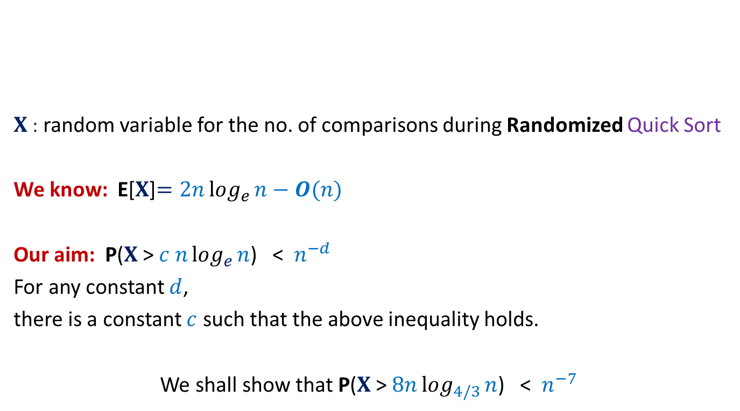


Concentration of running time of Randomized Quick Sort
$X$: random variable for the no. of comparisons during Randomized Quick Sort
We know: E[$X$]$=2nlog_{e}{n}−O(n)$
Our aim: P($X$ > $c nlog_{e}{n}$) < $n^{−d}$
For any constant $d$,
there is a constant $c$ such that the above inequality holds.
We shall show that P($X$ > $8nlog_{4/3}{n}$) < $n^{−7}$
$1$ …
$$n$$
A

Slide 4

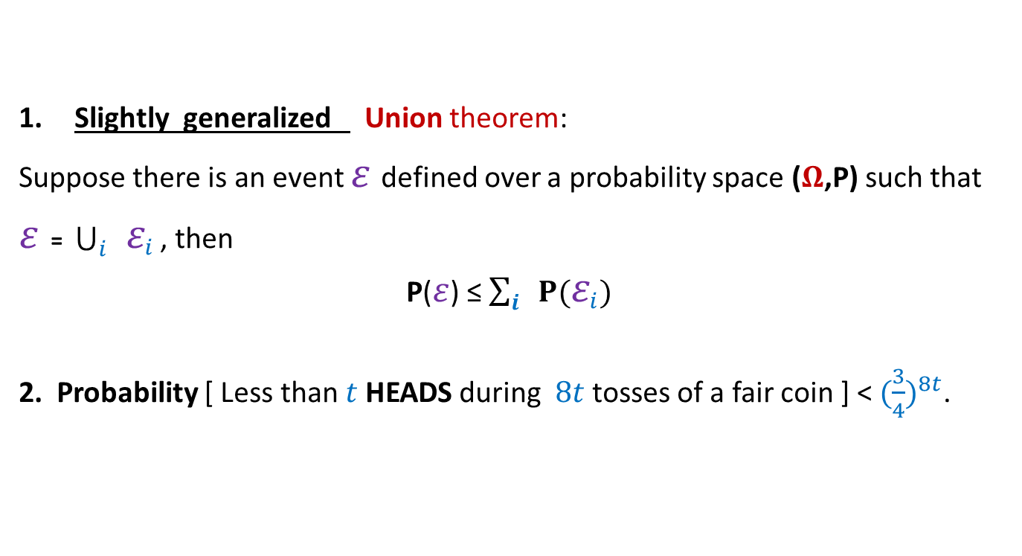
Concentration of running time of Randomized Quick Sort
Slightly generalized Union theorem:
Suppose there is an event $ε$defined over a probability space ($Ω$,P) such that
$ε$ = $\bigcup_{i}{ ε_{i}}$ , then
P($ε$) ≤ $\sum_{i}{ P(ε_{i})}$
2. Probability [ Less than $t$ HEADS during $8t$tosses of a fair coin ] < ${(\frac{3}{4})}^{8t}$.
Tools needed
$$⊆$$

Slide 5
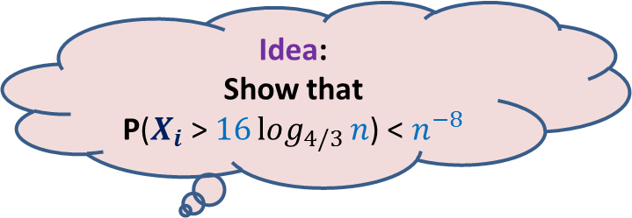





Randomized QuickSort
Idea:
Show that
P($X_{i}$ > $16log_{4/3}{n}$) < $n^{−8}$
Idea fails.
How to apply
Union Theorem ?
Aim: To show P($X$ > $8nlog_{4/3}{n}$) < $n^{−7}$
$X_{i}$ : number of comparisons that $e_{i}$ undergoes
$$X =\frac{1}{2} \sum_{i}{X_{i}}$$
$X$ > $8nlog_{4/3}{n}$ ➔ there exists at least one $i$ such that $X_{i}>16log_{4/3}{n}$
But P($X_{i}$ > $16log_{4/3}{n}$) > $n^{−1}$
Reason:
$e_{i}$ will be picked as the first pivot element
with prob. $n^{−1}$.
And so P($X_{i}$ = $n−1$)= $n^{−1}$.
?

Slide 6
What picture comes to your mind
when Randomized Quick sort makes too many comparisons ?

Slide 7


Recursion Tree
$n$= $25$
$$⌈log_{2}{n}⌉$$
Notes:
What picture comes to mind when Randomized Quick sort makes too many comparisons ?
Let us view the corresponding recursion tree.
There are elements in the recursion tree lying much deeper than $log_{2}{n}$
How to capture the ‘bad events’ in terms of such elements ?
Ponder over it …

Slide 8
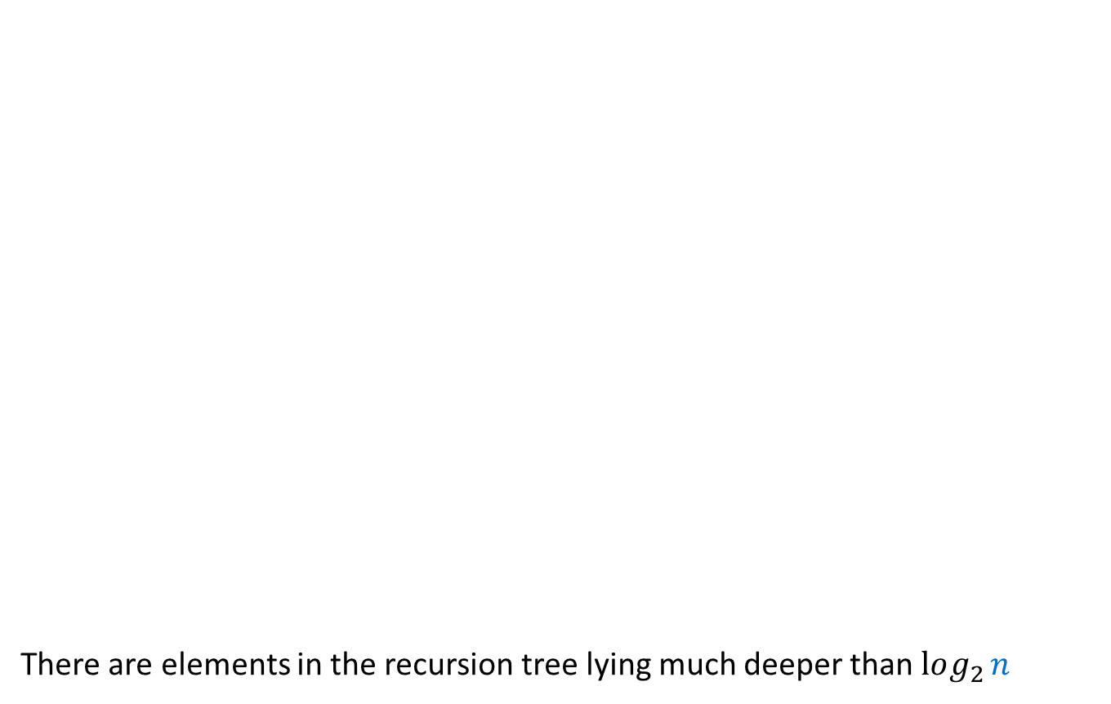
Recursion Tree
$n$= $25$
There are elements in the recursion tree lying much deeper than $log_{2}{n}$
$$⌈log_{2}{n}⌉$$
How to capture the ‘bad events’ in terms of such elements ?
Ponder over it …
Notes:
What picture comes to mind when Randomized Quick sort makes too many comparisons ?
Let us view the corresponding recursion tree.
There are elements in the recursion tree lying much deeper than $log_{2}{n}$
How to capture the ‘bad events’ in terms of such elements ?
Ponder over it …

Slide 9


Randomized Quick Sort
from perspective of $e_{i}$
Recursion Tree
$$e_{i}$$
Elements of A arranged in Increasing order of values

Slide 10

Randomized Quick Sort
from perspective of $e_{i}$
Recursion Tree
$$e_{i}$$
pivot
. . .
. . .

Slide 11
Randomized Quick Sort
from perspective of $e_{i}$
Recursion Tree
$$e_{i}$$
pivot

Slide 12
Randomized Quick Sort
from perspective of $e_{i}$
Recursion Tree
$$e_{i}$$
pivot

Slide 13
Randomized Quick Sort
from perspective of $e_{i}$
Recursion Tree
$$e_{i}$$
pivot

Slide 14
Randomized Quick Sort
from perspective of $e_{i}$
Recursion Tree
$$e_{i}$$

Slide 15

Randomized Quick Sort
from perspective of $e_{i}$
$Y_{i}$: no. of recursive calls in which $e_{i}$ participates before being selected as a pivot.
Question: Is there any relation between $X$ and $Y_{i}$ ?
Answer: $X=\sum_{i=1}^{n}{Y_{i}}$
Why ?

Slide 16
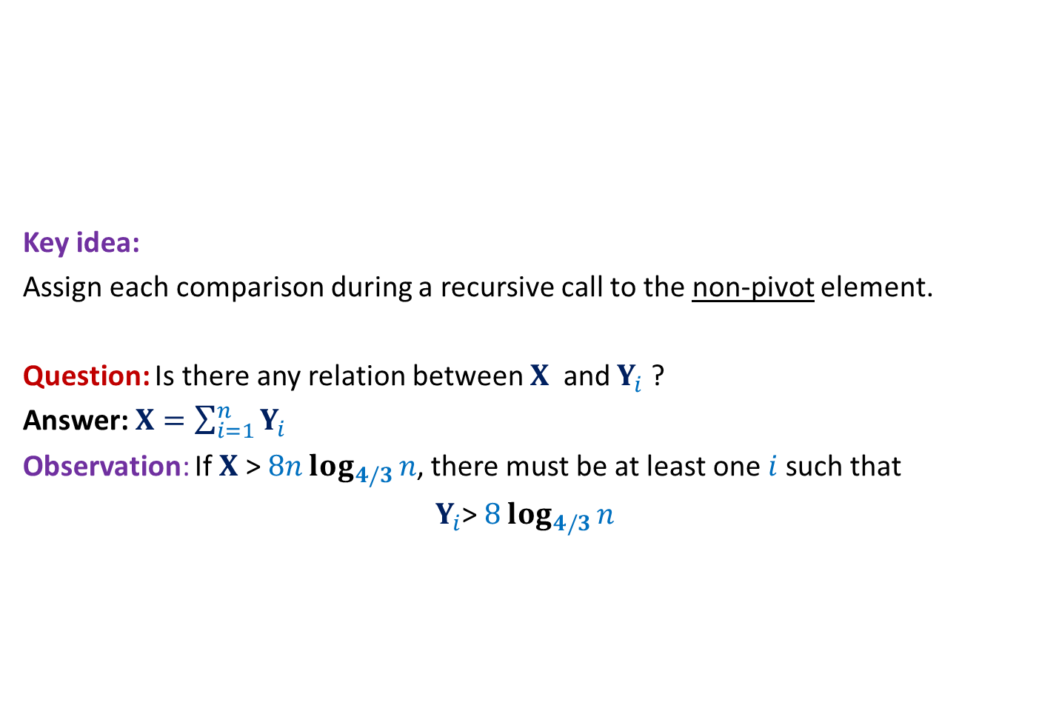
Randomized QuickSort A new way to count the comparisons
Elements of A arranged in Increasing order of values
Key idea:
Assign each comparison during a recursive call to the non-pivot element.
Question: Is there any relation between $X$ and $Y_{i}$ ?
Answer: $X=\sum_{i=1}^{n}{Y_{i}}$
Observation: If $X$ > $8nlog_{4/3}{n}$, there must be at least one $i$such that
$Y_{i}$> $8log_{4/3}{n}$

Slide 17

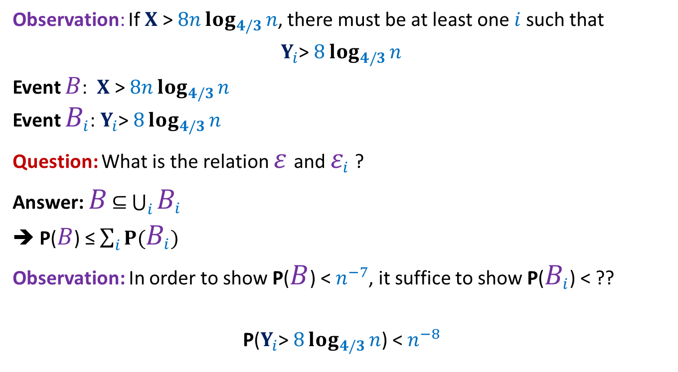
Randomized QuickSort Applying Union theorem
Observation: If $X$ > $8nlog_{4/3}{n}$, there must be at least one $i$such that
$Y_{i}$> $8log_{4/3}{n}$
Event $B$: $X$ > $8nlog_{4/3}{n}$
Event $B_{i}$: $Y_{i}$> $8log_{4/3}{n}$
Question: What is the relation $ε$and $ε_{i}$ ?
Answer: $B$ $⊆$ $\bigcup_{i}{B_{i}}$
➔ P($B$) ≤ $\sum_{i}{P(B_{i})}$
Observation: In order to show P($B$) < $n^{−7}$, it suffice to show P($B_{i}$) < ??
P($Y_{i}$> $8log_{4/3}{n}$) < $n^{−8}$
$$n^{−8}$$

Slide 18
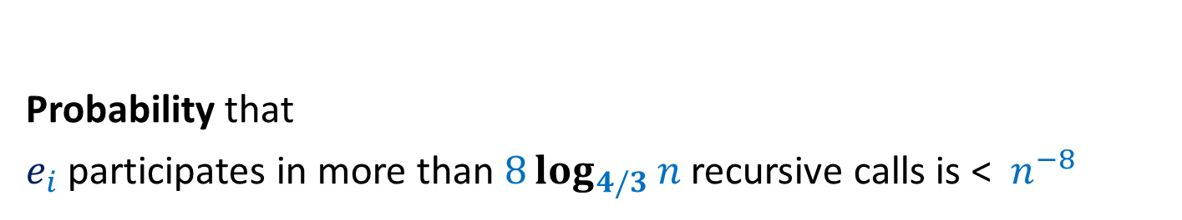

AIM: To show P($Y_{i}$> $8log_{4/3}{n}$) < $n^{−8}$
Probability that
$e_{i}$ participates in more than $8log_{4/3}{n}$ recursive calls is < $n^{−8}$

Slide 19

An Attempt
Show that
With high probability, size of $k$th recursive call < $\frac{n}{c^{k}}$ for some constant $c>1$
This approach looks difficult
Since the size of $k$th recursive call depends upon the first $(k−1)$ recursive calls.
How to proceed now ?

Slide 20

A Brilliant Idea
Increasing order of values
Definition:
a recursive call is good if the pivot is selected from the middle half,
and bad otherwise.
P(a recursive call is good) = ??
Notation: The size of a recursive call is the size of the subarray it sorts.
…
middle-half
$$\frac{1}{2}$$

Slide 21
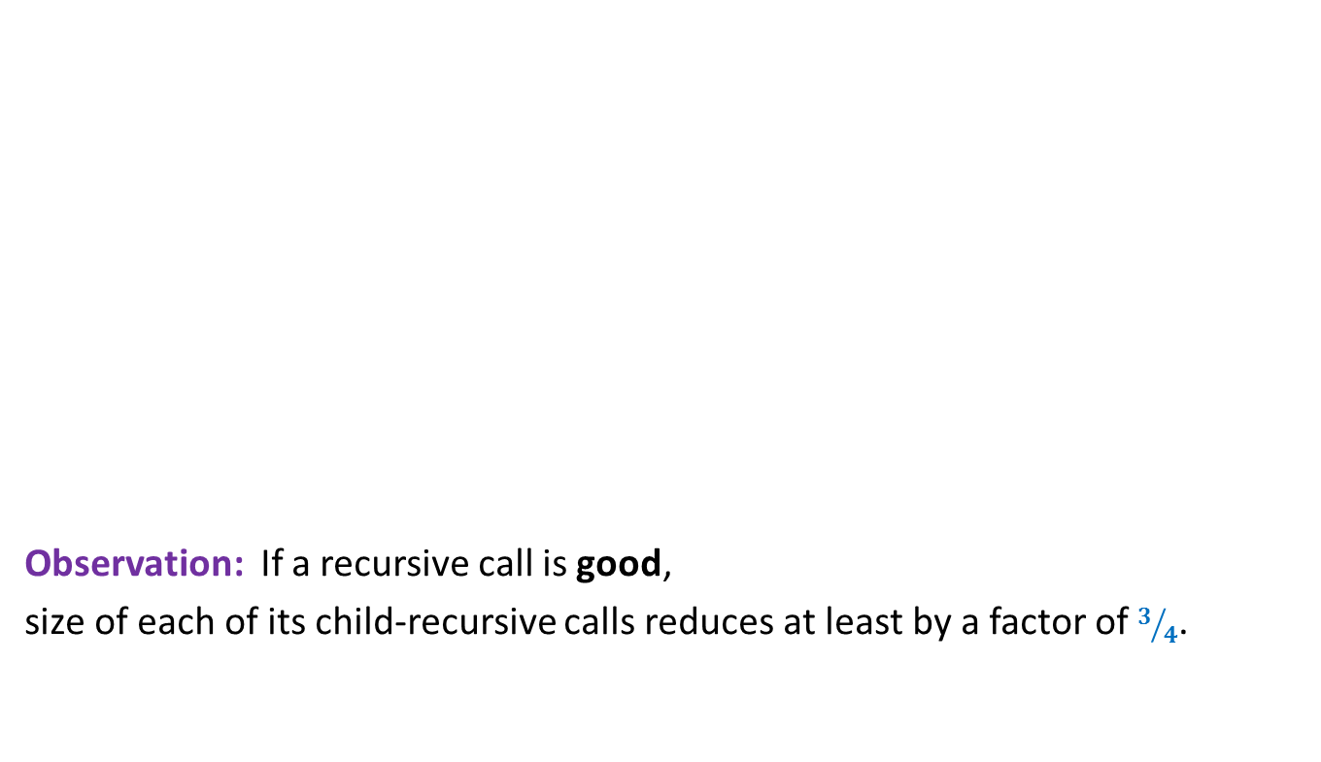
A Brilliant Idea
Increasing order of values
Observation: If a recursive call is good,
size of each of its child-recursive calls reduces at least by a factor of $3/4$.
…
middle-half

Slide 22

A Brilliant Idea
$$e_{i}$$
Increasing order of values
Question: What is the maximum no. of good recursive calls $e_{i}$can have in its lifetime?
Answer: $log_{4/3}{n}$.
…
middle-half

Slide 23


Randomized Quick Sort Summary from the perspective of $e_{i}$
During Randomized Quick Sort,
$e_{i}$Participates in a sequence of recursive calls
each of which is good independently with probability $1/2$.
$e_{i}$ leaves algorithm on or before participating in $log_{4/3}{n}$ good recursive calls.
$B_{i}$: $e_{i}$ participated in more than $8 log_{4/3}{n}$ recursive calls
With this insight, can you express this event in terms of any coin tossing event ?

Slide 24




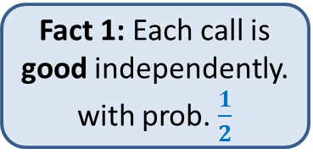
Randomized Quick Sort:
Recursive calls in which $e_{i}$appears
Fact 1: Each call is good independently. with prob. $\frac{1}{2}$
Our insight revealed two facts.
…
Fact 2: $e_{i}$ disappears on or before $log_{4/3}{n}$ good calls
…
$$8 log_{4/3}{n}$$
P[$e_{i}$ appears in more than $8 log_{4/3}{n}$ calls]

Slide 25
Randomized Quick Sort:
Recursive calls in which $e_{i}$appears
Good
Bad
…
Now relate it to some coin tossing experiment.
…
Make an attempt. ☺
$$8 log_{4/3}{n}$$
P[$e_{i}$ appears in more than $8 log_{4/3}{n}$ calls]

Slide 26


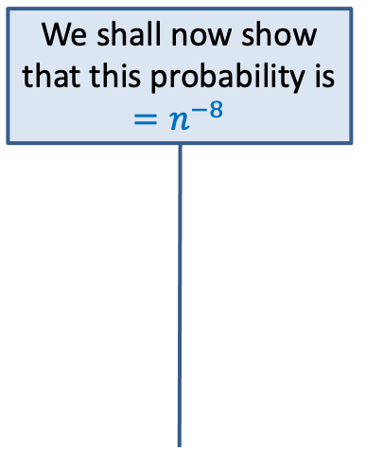

Randomized Quick Sort:
Recursive calls in which $e_{i}$appears
Experiment 1:
We toss a fair coin and
stop on getting $log_{4/3}{n}$ heads
T
T
Good
Bad
H
…
T
…
We shall now show that this probability is $=n^{−8}$
…
…
H
$$8 log_{4/3}{n}$$
T
$$≤$$
P[$e_{i}$ appears in more than $8 log_{4/3}{n}$ calls]
P[more than 8 $log_{4/3}{n}$ tosses are made]

Slide 27


Experiment 1:
Tossing a fair coin till we get $log_{4/3}{n}$ heads
P[more than $8 log_{4/3}{n}$ tosses are made]
Experiment 2:
Tossing a fair coin $8 log_{4/3}{n}$ times
P[less than $log_{4/3}{n}$ heads]
?
Intuitively the two probabilities look same.
However, the difficulty in establishing their equality arises since
the two sample spaces are different.
We can get rid of this difficulty by designing an experiment
that captures the essence of both the experiments.

Slide 28
Experiment 1:
Tossing a fair coin till we get $log_{4/3}{n}$ heads
P[more than $8 log_{4/3}{n}$ tosses are made]
Experiment 2:
Tossing a fair coin $8 log_{4/3}{n}$ times
P[less than $log_{4/3}{n}$ heads]
?

Slide 29

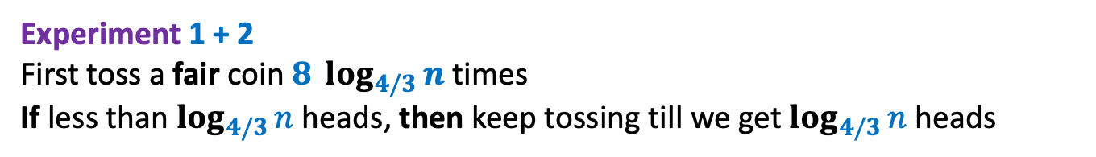

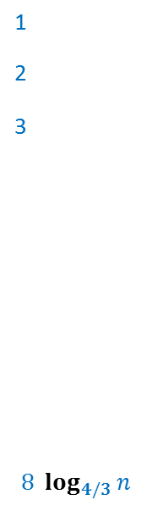
Experiment 1 + 2 First toss a fair coin $8 log_{4/3}{n}$times If less than $log_{4/3}{n}$ heads, then keep tossing till we get $log_{4/3}{n}$ heads
Clearly
P[more than $8 log_{4/3}{n}$ tosses are made to get $log_{4/3}{n}$ heads]
$$=$$
P[less than $log_{4/3}{n}$ heads in $8 log_{4/3}{n}$ tosses]
T
1
2
3
$$8 log_{4/3}{n}$$
T
H
$$<n^{−8}$$
T
…
…
The tool
H
T
T
…

Slide 30
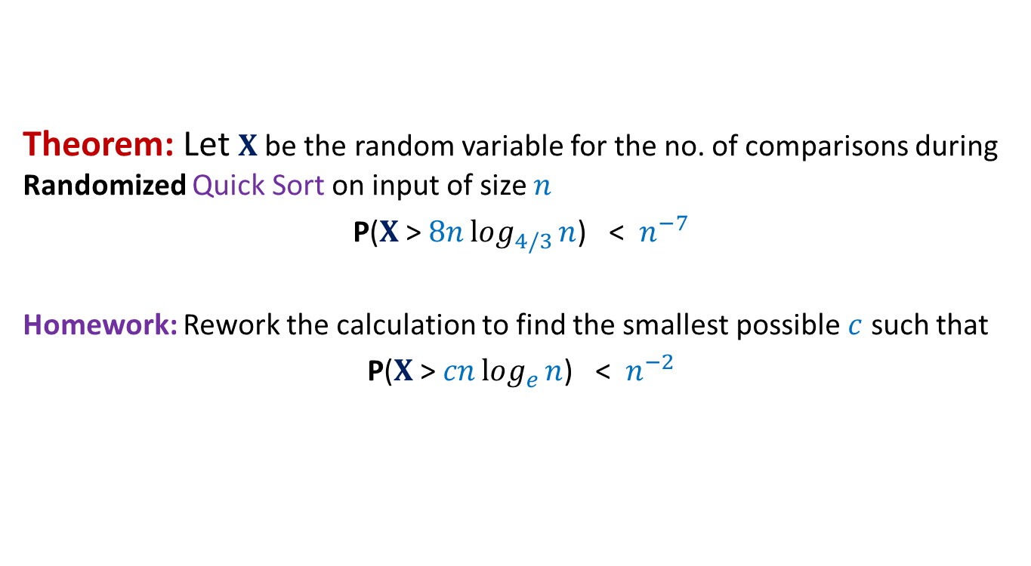
Randomized Quick Sort Final result
Theorem: Let $X$be the random variable for the no. of comparisons during Randomized Quick Sort on input of size $n$
P($X$ > $8nlog_{4/3}{n}$) < $n^{−7}$
Homework: Rework the calculation to find the smallest possible $c$ such that
P($X$ > $cnlog_{e}{n}$) < $n^{−2}$

Slide 31
Randomized algorithm for Primality

Slide 32


$n$: composite number
$A$: {$1,2,…,n−1$}
$A_{fermat}$: set of numbers $a∈A$such that $a^{n−1}mod n≠ 1$
Question:
Can we get a worst case guarantee on $\frac{\left|A_{fermat}\right|}{|A|}$ ?

Slide 33





$n$: composite number
$A$: {$1,2,…,n−1$}
set of elements $a∈A$ s.t. gcd($a,n$)$=1$
set of elements $a∈A$ s.t. gcd($a,n$)$≠1$
$$⊂^{?}A_{fermat}$$
$$⊂^{?}A_{fermat}$$

Slide 34
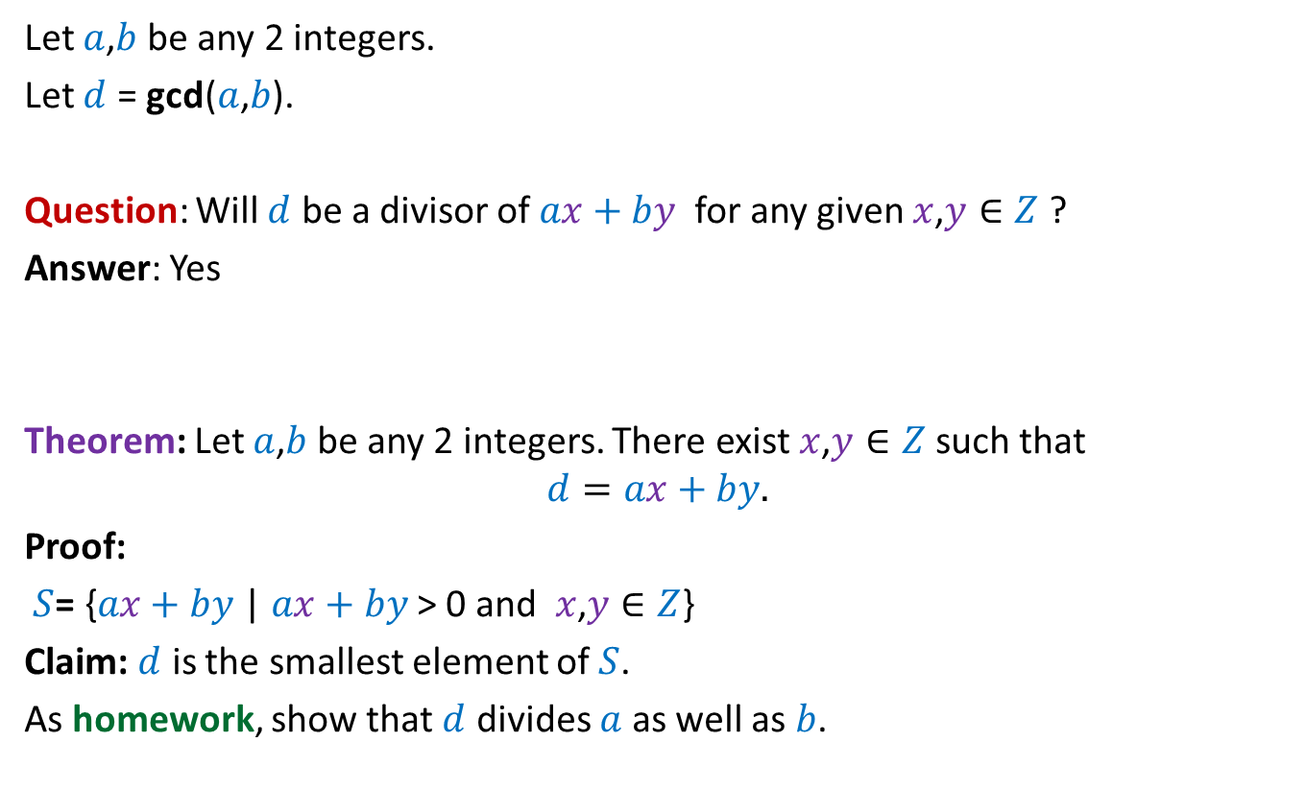
An interesting theorem on GCD
Let $a$,$b$ be any 2 integers.
Let $d$ = gcd($a$,$b$).
Question: Will $d$ be a divisor of $ax+by$ for any given $x$,$y∈Z$ ?
Answer: Yes
Theorem: Let $a$,$b$ be any 2 integers. There exist $x$,$y∈Z$ such that
$$d=ax+by.$$
Proof:
$S$= {$ax+by$ | $ax+by$ > 0 and $x$,$y∈Z$}
Claim: $d$ is the smallest element of $S$.
As homework, show that $d$ divides $a$ as well as $b$.

Slide 35
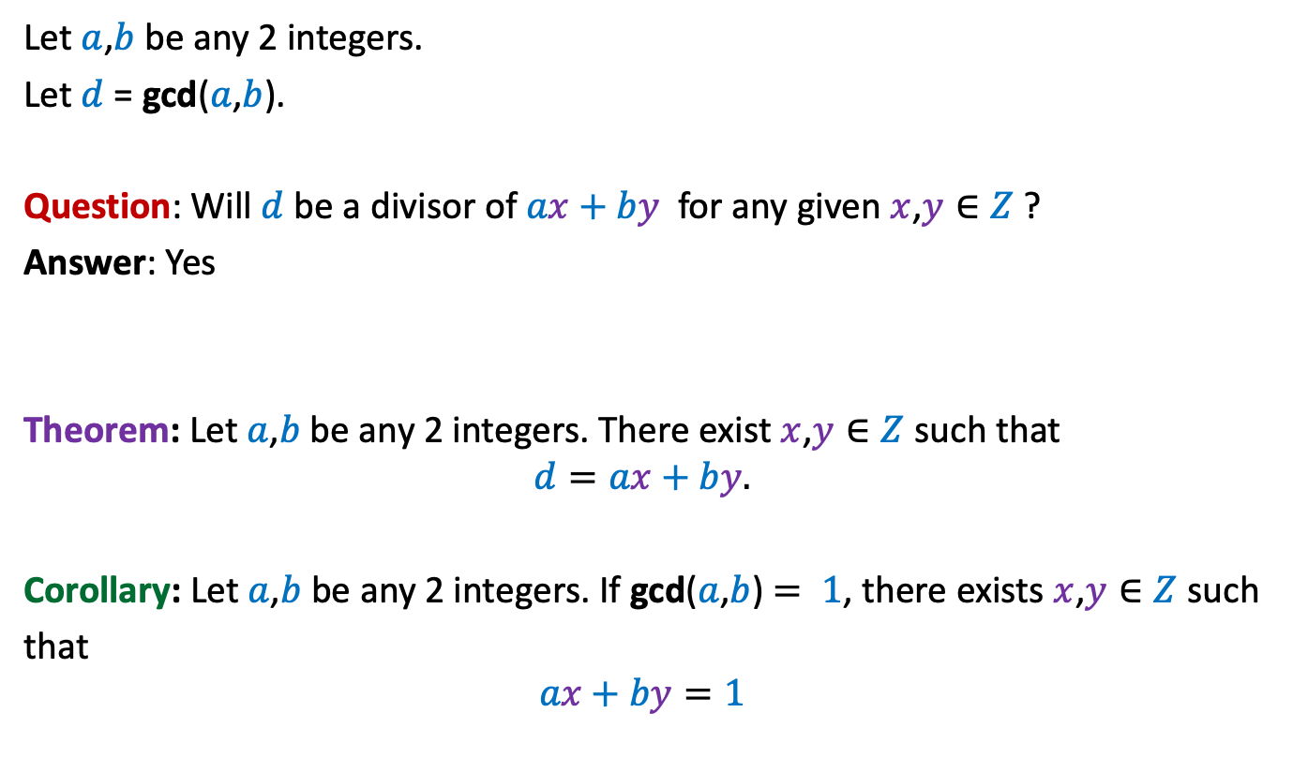
An interesting theorem on GCD
Let $a$,$b$ be any 2 integers.
Let $d$ = gcd($a$,$b$).
Question: Will $d$ be a divisor of $ax+by$ for any given $x$,$y∈Z$ ?
Answer: Yes
Theorem: Let $a$,$b$ be any 2 integers. There exist $x$,$y∈Z$ such that
$$d=ax+by.$$
Corollary: Let $a$,$b$ be any 2 integers. If gcd($a$,$b$) $= 1$, there exists $x$,$y∈Z$ such
that
$$ax+by=1$$

Slide 36

$n$: composite number
$A$: {$1,2,…,n−1$}
Suppose $a^{n−1}mod n =1$
$a^{n−1}=kn+1$
$a^{n−1}−kn=1$
$\left(a^{n−2}\right)a+\left(−k\right)n=1$
set of elements $a∈A$ s.t. gcd($a,n$)$=1$
set of elements $a∈A$ s.t. gcd($a,n$)$≠1$
$$⊂^{?}A_{fermat}$$
$$⊂^{?}A_{fermat}$$
contradiction

Slide 37


$n$: composite number
$A$: {$1,2,…,n−1$}
set of elements $a∈A$ s.t. gcd($a,n$)$=1$
set of elements $a∈A$ s.t. gcd($a,n$)$≠1$
$$⊂^{?}A_{fermat}$$
$$⊂A_{fermat}$$

